Slide 1
Obscure Movie Recommendation Engine
Nathan Gardner
BAS 479

Slide 2

The Perfect Movie Recommender is Imperfect
A user wants:
Movies he/she would be interested in
Movies he/she has not seen yet
Recommending movies tailored to the user is easy. Recommending movies unseen by the user is easy. Doing both at the same time is tricky!

Slide 3
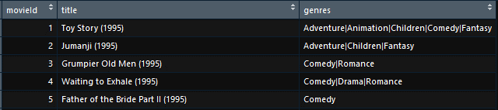
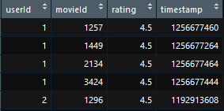
Data Overview
Data Sneak Peaks
Data obtained from MovieLens dataset
Data contains:
27 million observations
280,000 users
9 unique columns across each file

Slide 4
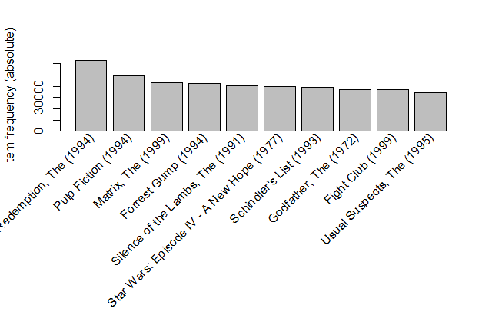
How Does It Work?
Market Basket Analysis (Association Rules)
Top 10 Most Liked Movies
The engine looks for combinations of reviewer’s movie “likes” that appear frequently together
A user “likes” a movie if they rated it 4.5 or above
Rules are created from combinations
The engine returns a table of movies based on the specified parameters (popularity, confidence, and number)

Slide 5
Walkthrough Using My Favorite Movies
A List of My Favorite Movies
4 Steps to get recommendations:
Input favorite movies
Specify parameters
Run code
Get results

Slide 6
Inputting Movies
Steps to finding your movie:
Use the following code to find the exact movie name:
itemLabels(TRANS)[ grep(“YOUR_MOVIE", itemLabels(TRANS) ) ]
Copy and paste the result into a list called “likes”
Likes <- c(“Your_Movie1”, “Your_Movie2”,…)

Slide 7
Specifying Parameters
Example Function Call and Results
There are 6 arguments in the recommend function:
likes – List of your favorite movies (At least 5 or so)
TRANS – The Data used to recommend
confidence – The minimum confidence of the recommendations (default = .25)
number – How many recommendations you want (default = 8)
popularity – The maximum percent of reviewers who liked the movie (default = .001)
All100conf – Returns all movies with 100% confidence if set to TRUE (default = FALSE)

Slide 8
Results Analyzed
The function returned 10 results that had a confidence higher than 75% and had a popularity lower than .5%
The lower the popularity, the less “liked” the movie is
The higher the confidence, the more likely it is that the user will the movie.
Setting confidence too high or popularity too low may not return enough results. To fix, increase the number of movies in the list of likes, or adjust the parameters (increase popularity or decrease confidence)

Slide 9
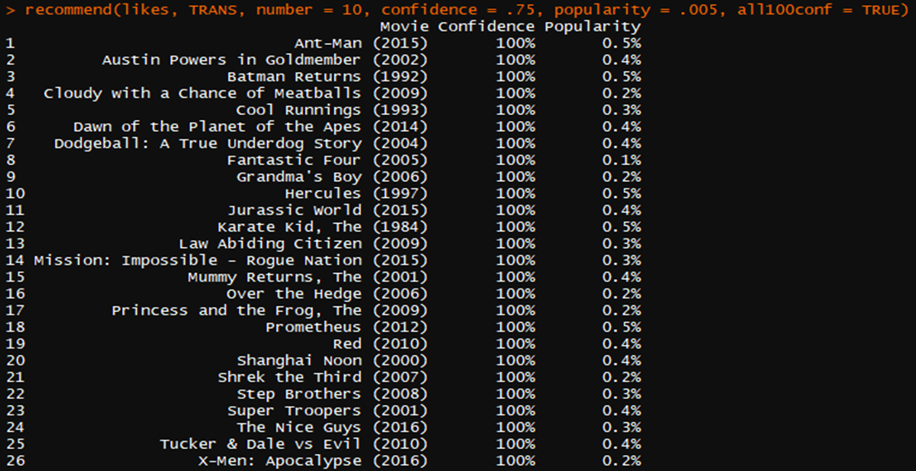
Results Analyzed Continued
Recommendations After all100conf = TRUE
Notice that the movies all have 100% confidence and are all in alphabetical order
If the user wants all movies that had 100% confidence, add the all100conf = TRUE argument to the recommend function
This argument revealed 16 more movies with 100% confidence that would otherwise have been missed!

Slide 10
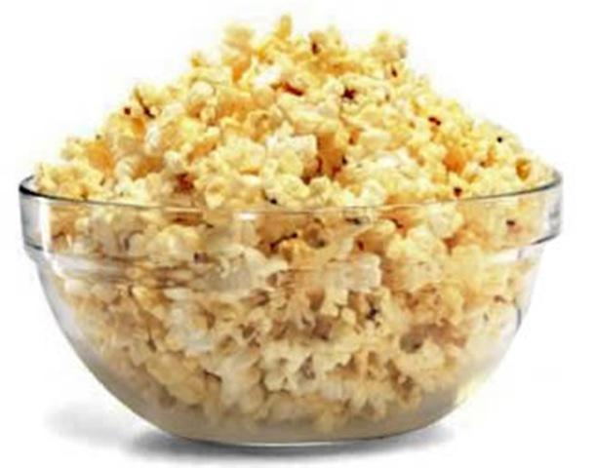
Potential Improvements
The ability to order the data by confidence and then popularity
Improved search ability/automatic input into likes list
The ability to only recommend movies of a certain genre or from a time period
Boxplots showing the rating distributions for each movie. (This could be summary statistics for each recommended movie, too)
Links to either the IMDB or TMDB pages for the movies

Slide 11
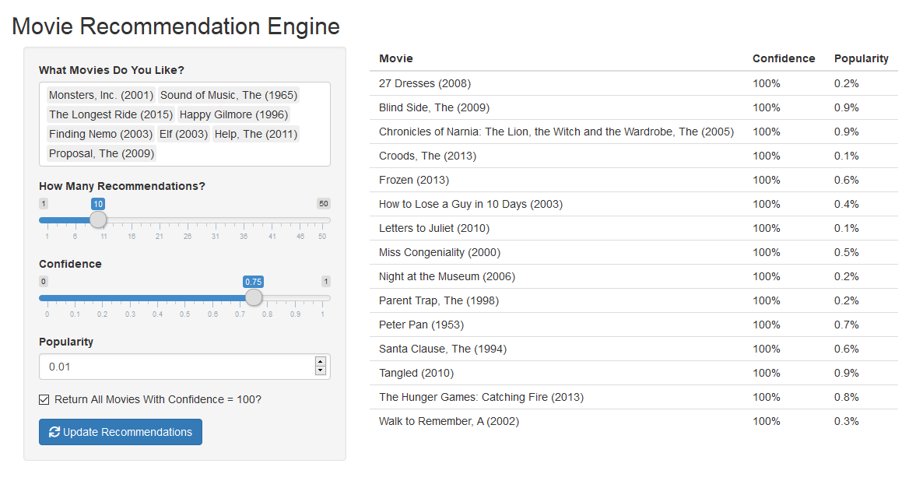
Bonus! GUI for Recommendation Engine
Features intuitive search option
Interactive sliders and input options
Built using Shiny

